Slide 1

Automatic Accident Detection and Rescue Management System
Presented By
Abhishek Fartade (230340130001)
Ankita Mishra (230340130009)
Gaikwad Atul Jalindar (230340130019)
Jadhav Abhishek Devidas (230340130020)
Riya Soni (230340130043)
Department of PG Diploma in Embedded Systems and Design(PG-DESD)
C-DAC’s Advanced Computing Training School, Pune

Slide 2
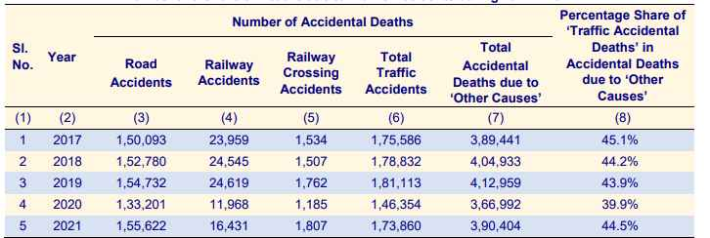
Introduction:-
The constant improvement of technology leading to civilization in search of better prospects as expected an implosion of transportation system is observed that increment in number of vehicles on road result in increased chance of vehicular accidents.
The accidents must be reported immediately in order to provide quick and proper medical assistance because there is also rise in unreported accidents.

Slide 3
Objectives:-
The accidents must be detected immediately using accelerometer MPU-6050, in order to provide quick and proper medical assistance.
Have minimum false detection using force detection sensor as Piezoelectric crystal.
Able to send the latitude and longitude if the accident or any emergency situation arises, via SIM900A module.
Implementation of additional safety features like parking assist and proximity safety alert system using ultrasonic sensor HCSR-04. able to manage the light system of the vehicle based on the ambient environment via photo diode BH1750.
Design Infotainment system for OLED Display Module and able to control the speed of the vehicle by applying advanced Breaking System
Capture the Temperature and Humidity and accordingly manage the HVAC system based on the user preferences and all the important parameters will be send over the IoT Platform.

Slide 4
Components:-
Hardware:- Software:-
ESP32-WROOM-32 FreeRTOS
MPU-6050
NEO-6M Protocol:-
HCSR-04 MQTT
BH1750 UART
Buzzer
Display Platform:-
Piezoelectric crystal Arduino IDE
SIM900A

